Slide 1

Calculation of Age-Adjusted Hearing Loss April 19, 2023
Catherine Boomus, MD, MPH

Slide 2
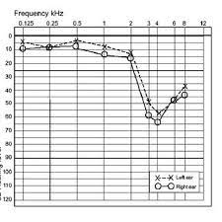
Background
OSHA regulation §1910.95
Workers in the United States exposed to noise must be in a hearing conservation program
Includes periodic hearing tests (audiometry)
Difference between baseline and current loss; needs adjustment for age-related loss. Calculation too confusing for medical staff
Standard threshold shift or recordable injury
Current available programs do not allow calculations based on test inputs when baselines are inappropriately noted or determined by AI

Slide 3
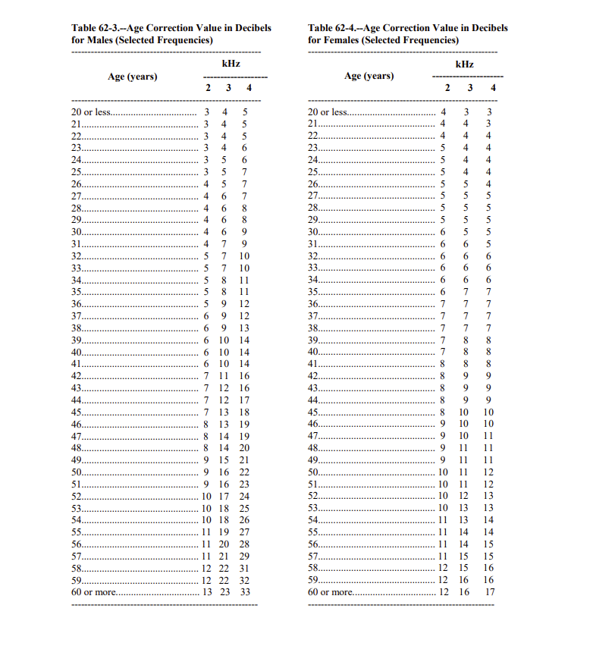
Age Adjustment Table
For each frequency, subtract age adjustment of current age from baseline. Average differences for each ear – that’s the age-related component of loss.

Slide 4
Program to calculate the age-adjusted hearing loss (Tkinter, Pandas, Numpy)
Input the sex, baseline age, and current age for each ear
Entry using Tkinter
Input baseline and current pure tone audiometry data (dB loss at 2000, 3000, and 4000 Hz for each ear)
Retrieve CSV data using Pandas
With reference to Male or Female sex of the patient, baseline age, and current age, get the adjustments
Do the math, using Numpy
Determine shift or recordable injury
Access and display
the result
Calculate the difference between the two sets of data and the adjustment for the difference in age expected from age
Entry using Tkinter

Slide 5
Results: CSV file, output, Tkinter frame

Slide 6


Thank You

